Slide 1

_StudPath_

Slide 2

Over 60% of colleges struggle to effectively manage and track the progress of their large student populations

Slide 3

Studpath:-
Simplifying Your
Success Journey
By -Tracking your Academic
Journey

Slide 4


Tracking the Complete Journey
1
Academics
Track courses, grades, deadlines, and progress toward graduation requirements.
2
Career
Explore career paths, build a professional portfolio, and connect with potential employers.
3
Personal Development
Set goals, track progress, and access resources to enhance personal growth and well-being.

Slide 5

Vision
Mission
To empower students and enhance their academic excellence through personalized education.
To create a comprehensive platform that simplifies the college journey, fosters student success, and strengthens the college community.

Slide 6
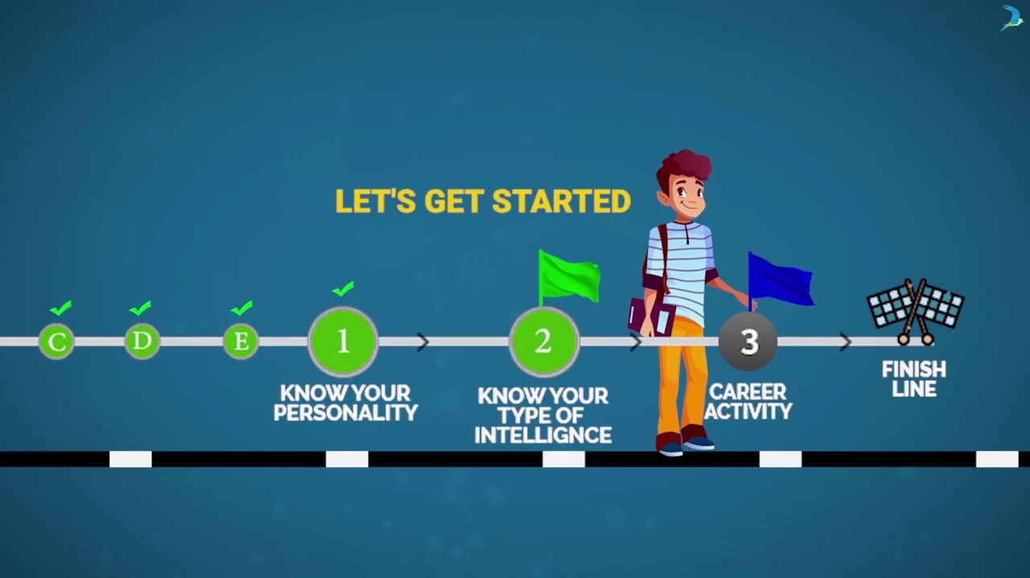
Personalized Student Management System
Personalized Recommendations
Student Data
Progress Tracking
Collects and analyzes student data to understand individual needs and provide targeted support.
Offers tailored recommendations for courses, internships, mentorship opportunities, and other relevant resources.
Monitors student progress and identifies potential areas for improvement, providing timely interventions.

Slide 7





Improving College Experiences
Stronger Community
Fosters a sense of belonging and community by connecting students
with peers, mentors, and faculty.
Improved Communication
Provides a platform for seamless communication between students,
faculty, and staff.
Increased Engagement
Encourages active participation in campus events, clubs, and
organizations.
Higher Success Rates
Ultimately aims to improve student retention, graduation rates, and
overall success.

Slide 8


Studpath's Unique Offerings
1 .Comprehensive Tracking
Tracks academic, career, and personal development progress in one central platform.
2. Personalized Recommendations
Provides tailored suggestions for courses, internships, and other resources based on student data.
3. Data-Driven Insights
Analyzes student data to identify trends and areas for improvement, enabling institutions to provide better support.

Slide 9
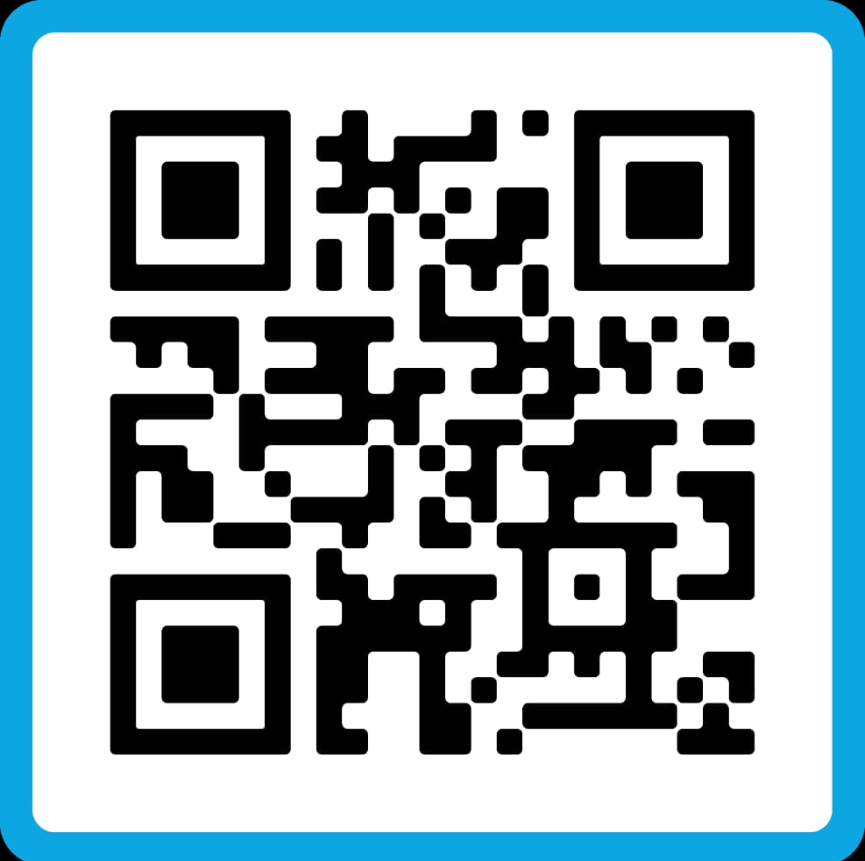

Instagram QR
Linkedin QR

Slide 10
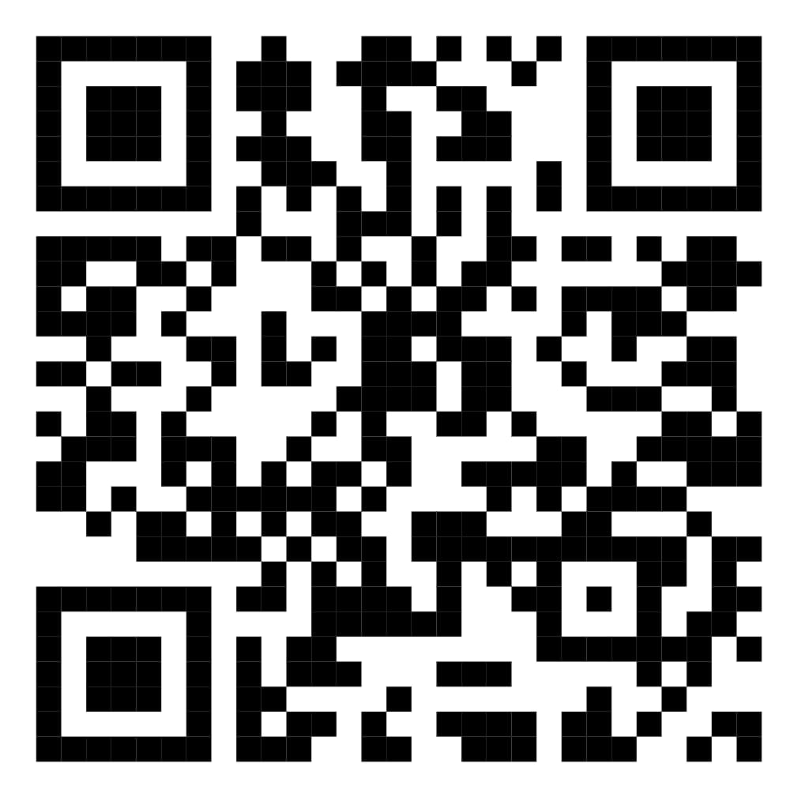

Feedback Form

